Slide 1
Process
sys_read()
sys_write()
User
Kernel
Virtual File System
File System &Virtual File System
Page Cache
Mapping Layer (FS Specific)
Block I/O Layer
Block Device Driver
Devices
(e.g., HDD, SSD)

Slide 2
Filesystem – What Users Know
Process
Filesystem: Method and data structure that the operating system uses to control how data is stored and retrieved.
Without the filesystem, data will be one large body on storage media. (Hard to separate and identify.)
Linux supports many filesystems:
Disk-based filesystems: Storing files on non-volatile block-oriented media to retain their contents. (e.g., Ext3/4, XFS, exFAT)
Network filesystems: The files might be on a different system. Carried out over a network connection.
Analog I/O systems to Library:
Library users (Applications) request books (Files)
The catalog system (File System) locates the book
The library staff (Block Layer) physically gets the book from the correct shelf and slot (Devices analog to bookshelves).
C-Standard Library (Libc)
sys_read()
sys_write()
Userspace
Kernel
Virtual File System
Page Cache
Filesystems (Ext4, XFS, …)
Block I/O Layer
Block Device Driver
Devices
(e.g., HDD, SSD)
https://en.wikipedia.org/wiki/File_system
http://byteliu.com/2019/05/10/Linux-The-block-I-O-layer/
Notes:
Virtual filesystems: generated in the kernel itself and are a simple way of enabling userspace programs to communicate with users.

Slide 3
Recall: Filesystem – File and Directories
File: a linear array of bytes that can be read/written
Each file has a low-level name (or inode number) that uniquely identifies itself in the file system. (Often, the user is not aware of this name.)
A directory is just a special type of file with specific content.
Each directory has an inode number as well.
Directory Tree (Leaf node: File, Non-Leaf node: Directory):
/ is the root directory.
/ is also a “separator” to name subsequent files.
A files referred by the absolute pathname (From root).
Directories and files can have the same name.
For Linux, no difference between files and directories
Linux doesn’t care about the file extension.
/
tmp2
tmp
Hi.sh
tmp
Hi.txt
MC Slides

Slide 4
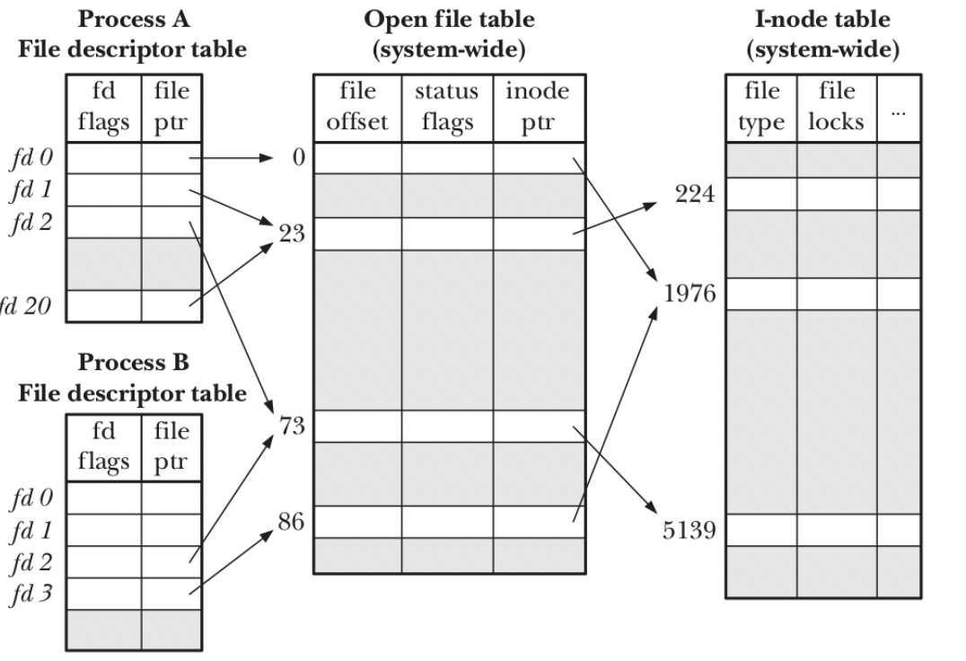
Recall: Filesystem – More Technical
File Descriptor: An integer to identify the open file in all file-related operations.
Assigned by the kernel when a file is opened and is valid only within a process.
Two processes may use the same file descriptor, but it does not point to the same file.
Inode: Each file (or directory) has just one inode. Contains metadata such as access rights, date, pointers to the file data.

Slide 5
Recall: Filesystem – More Technical (Count.)
The design of open file table can relax the complexity of inode table.
Ex1: Process A and B open the same file (fd0 in A, fd3 in B)
Individual access mode
Individual file offset
Shared ref count
Use file descriptor to get a lock
Ex2: Process B inherits files from Process A (e.g., fd2)
Process A forks Process B

Slide 6
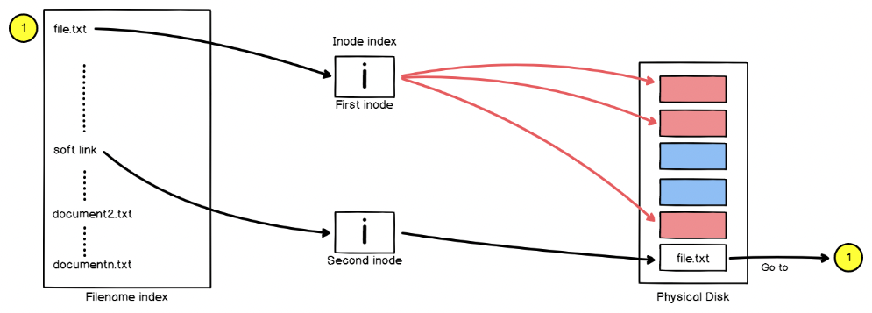
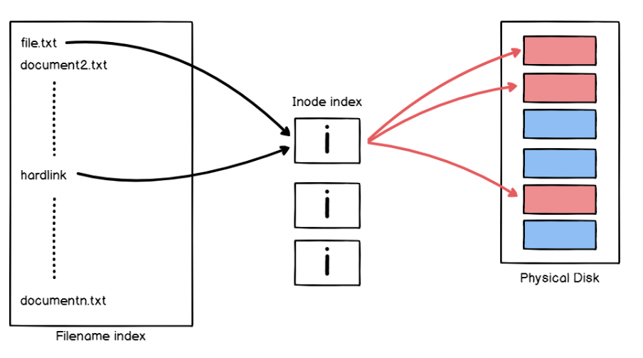
Filesystem – Soft & Hard Links
Soft Links
Soft Links: A separate file (called shortcut) contains a path or reference to the target file or directory. (Only one real file)
Hard Links: The file shares all the attributes of the original file, even the inode number. (counter to monitor the number of links)
Hard Links
https://devconnected.com/understanding-hard-and-soft-links-on-linux/
Notes:
Creating a soft link will create a new inode and directory entry, but creating a hard link will only create a new directory entry

Slide 7
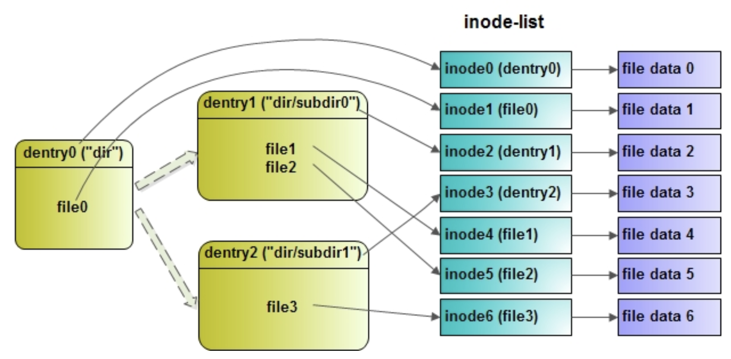
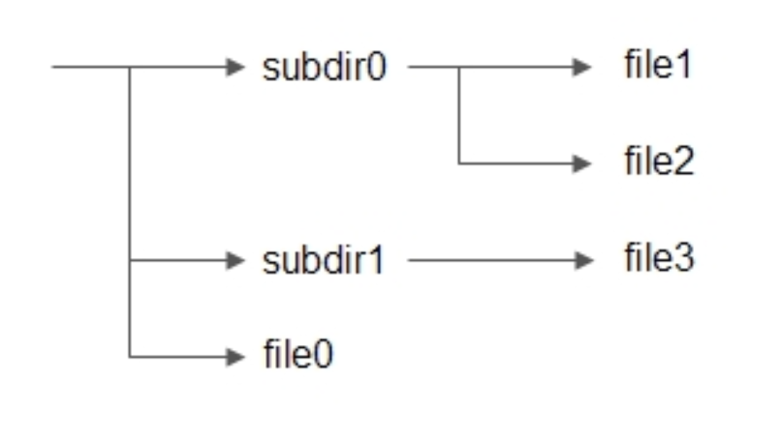
Layout Concepts of a FS (On Storage Device)
An overview of key data structures used by a file system.
Inode for “dir” directory
Storage Devices
Inode Table
Physical Layout of a file system on the disk (not VFS)
Boot Block
Super Block
Root Dir
File1’s Content in Data Block
subdir0
File2
Directory Block
Directory Entries
Inode4, file1’s filename
Inode5, file2’s filename
Ref: https://www.modb.pro/db/444637
Notes:
https://connorbrereton.medium.com/whats-an-inode-and-what-s-inside-of-one-linux-first-principles-63d0c8621ec0 A directory is a file that contains directory entries. Special types of files serve as containers for storing files and other directorie Data block vs Directory Block Directory Entries: Each directory entry corresponds to a file or subdirectory within the directory. It contains metadata about the file or subdirectory, such as the filename, inode number, file type, and possibly additional information depending on the file system. Inode Number: the inode number of the corresponding file or subdirectory. The inode contains detailed information about the file, such as its permissions, ownership, size, and pointers to the data blocks that store the file's contents.

Slide 8
Recall: Log-Structure File System
Sequential Accesses: Write data in a sequential order is not enough. Must issue a large number of contiguous writes. (Reason: A disk rotates all the time)
Write Buffering: Buffer all updates (including metadata) in an in-memory segment, and write a bunch of data (i.e., segment) to a disk in a batch.
Segment
D_{j,0}
D_{j,1}
D_{j,2}
D_{j,3}
Inode_{j}
B[0]:A₀
B[1]:A₁
B[2]:A₂
B[3]:A₃
D_{k,0}
Inode_{k}
B[0]:A₅
Write Buffer
HDD
A₀
A₁
A₂
A₃
A₄
A₅
A₆

Slide 9
Log-Structure File System (Count.)
But, how to find an inode in the disk?
Old UNIX FS: Organized in an array and place on disk at fixed location
LFS: Inodes are scattered all over the disk.
Why inode map: Can track each inode easily and efficiently.
Sol: Inode Map (Inode# → Address)
Old Unix File System
Inode stored at a known fixed location
D₁
D₂
Inode₁
Inode₂
Inode₃
Inode_{N-1}
Inode_{N}
HDD
…
…
…
A_{i}
A_{j}
A_{start}
A_{inode} = A_{start} + inode_{index} * inode_{size}
Inodes are scattered
LFS (Indirection)
D_{j,0}
D_{j,1}
D_{j,2}
D_{j,3}
Inode_{j}
B[0]:A₀
B[1]:A₁
B[2]:A₂
B[3]:A₃
D_{k,0}
Inode_{k}
B[0]:A₅
Imap_{k-n}
I[k]:A₇
…
I[n]:A_{z}
Imap_{0-j}
I[0]:A_{x}
I[1]:A_{y}
…
I[j]:A₄
HDD
A₀
A₁
A₂
A₃
A₄
A₅
A₆
A₇
A₈
Notes:
New writes to data block would also update inode. Thus, the position of inode changes

Slide 10
Log-Structure File System (Count.)
How to find the corresponding inode map
Checkpoint Region: Fixed and known region on the disk. It contains pointers to the latest pieces of the inode map.
Performance Consideration: Update periodically (e.g., 30 secs)
Known fixed location
Checkpoint Region
Imap[0-j]: A₅
Imap[k-n]: A₈
D_{j,0}
D_{j,1}
D_{j,2}
D_{j,3}
Inode_{j}
B[0]:A₀
B[1]:A₁
B[2]:A₂
B[3]:A₃
Imap_{0-j}
I[0]:A_{x}
I[1]:A_{y}
…
I[j]:A₄
D_{k,0}
Inode_{k}
B[0]:A₅
Imap_{k-n}
I[k]:A₇
…
I[n]:A_{z}
HDD
A₀
A₁
A₂
A₃
A₄
A₅
A₆
A₇
A₈

Slide 11
Log-Structure File System (Count.)
What about Directories (/D_{dir}/D_{j})
A directory is just a collection of (name, inode number) mappings.
A directory like a file has their own inode.
Challenge without inode map: recursive update problem
Update test (or D_{j})
D_{j}
Inode_{j}
B[0]:A₀
D_{dir}
(test, j)
Inode_{dir}
B[0]:A₂
Imap
I[dir]:A₃
I[j]:A₁
D_{j}
Inode_{j}
B[0]:A₅
Imap
I[dir]:A₃
I[j]:A₆
HDD
A₀
A₁
A₂
A₃
A₄
A₅
A₆
A₇
Update test (or D_{j})
Recursive update problem affects parents
D_{j}
Inode_{j}
B[0]:A₀
D_{dir}
(test, j, A₀)
Inode_{dir}
B[0]:A₂
D_{j}
Inode_{j}
B[0]:A₄
D_{dir}
(test, j, A₄)
Inode_{dir}
B[0]:A₆
HDD
A₀
A₁
A₂
A₃
A₄
A₅
A₆
A₇

Slide 12
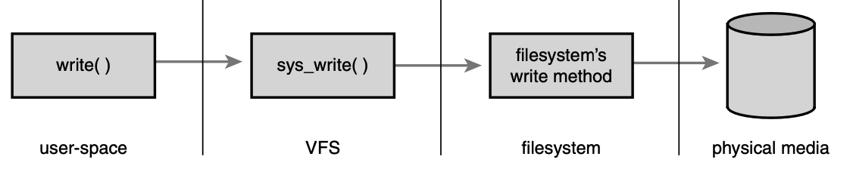
What is Virtual Filesystem (VFS)
Enables programs to use standard Unix system calls to work regardless of the filesystem or underlying physical medium.
Together, the VFS and the block I/O layer provide the abstractions that allow user-space programs to issue generic system calls to access files via a uniform naming policy on any filesystem, which itself exists on any storage medium.
This abstract layer mirrors a filesystem (Ext2) and defines the basic conceptual interfaces and data structure. (e.g., files and directories)

Slide 13
VFS Objects and Data Structures (Metadata)
Four primary object types of VFS (also fs-related abstractions):
Superblock Object: Represents a specific mounted file system.
inode (Index Node) Object: Represents a specific file.
dentries Object: Represents a directory entry, which is a single component of a path. (e.g., /usr/home/tmp → At least four dentries)
File Object: Represents an open file as associated with a process.
The VFS treats directories as normal files, so there is not a specific directory object. (dentry != directory. Directory is just another kind of file)
Ref: https://www.gushiciku.cn/pl/g4f9/zh-tw

Slide 14
VFS Objects and Data Structures (Metadata)
Four primary object types of VFS (also fs-related abstractions):
Superblock Object: Represents a specific mounted file system.
inode (Index Node) Object: Represents a specific file.
dentries Object: Represents a directory entry, which is a single component of a path.
File Object: Represents an open file as associated with a process.
The VFS treats directories as normal files, so there is not a specific directory object. (dentry != directory. Directory is just another kind of file)
Operations objects describe the methods belonging to each primary objects.
The specific instance of the filesystem (e.g., ext4, XFS, …) fills link with its own filesystem-specific methods
Super_operations: Methods that kernel can invoke on a specific FS, e.g., sync_fs()
Inode_operations: Methods that kernel can invoke on a specific file, e.g., create(), link()
Dentry_operations: Methods that kernel can invoke on a specific directory entry, e.g., d_delete()
File_operations: Methods that the process can invoke on an open file, e.g., read()

Slide 15
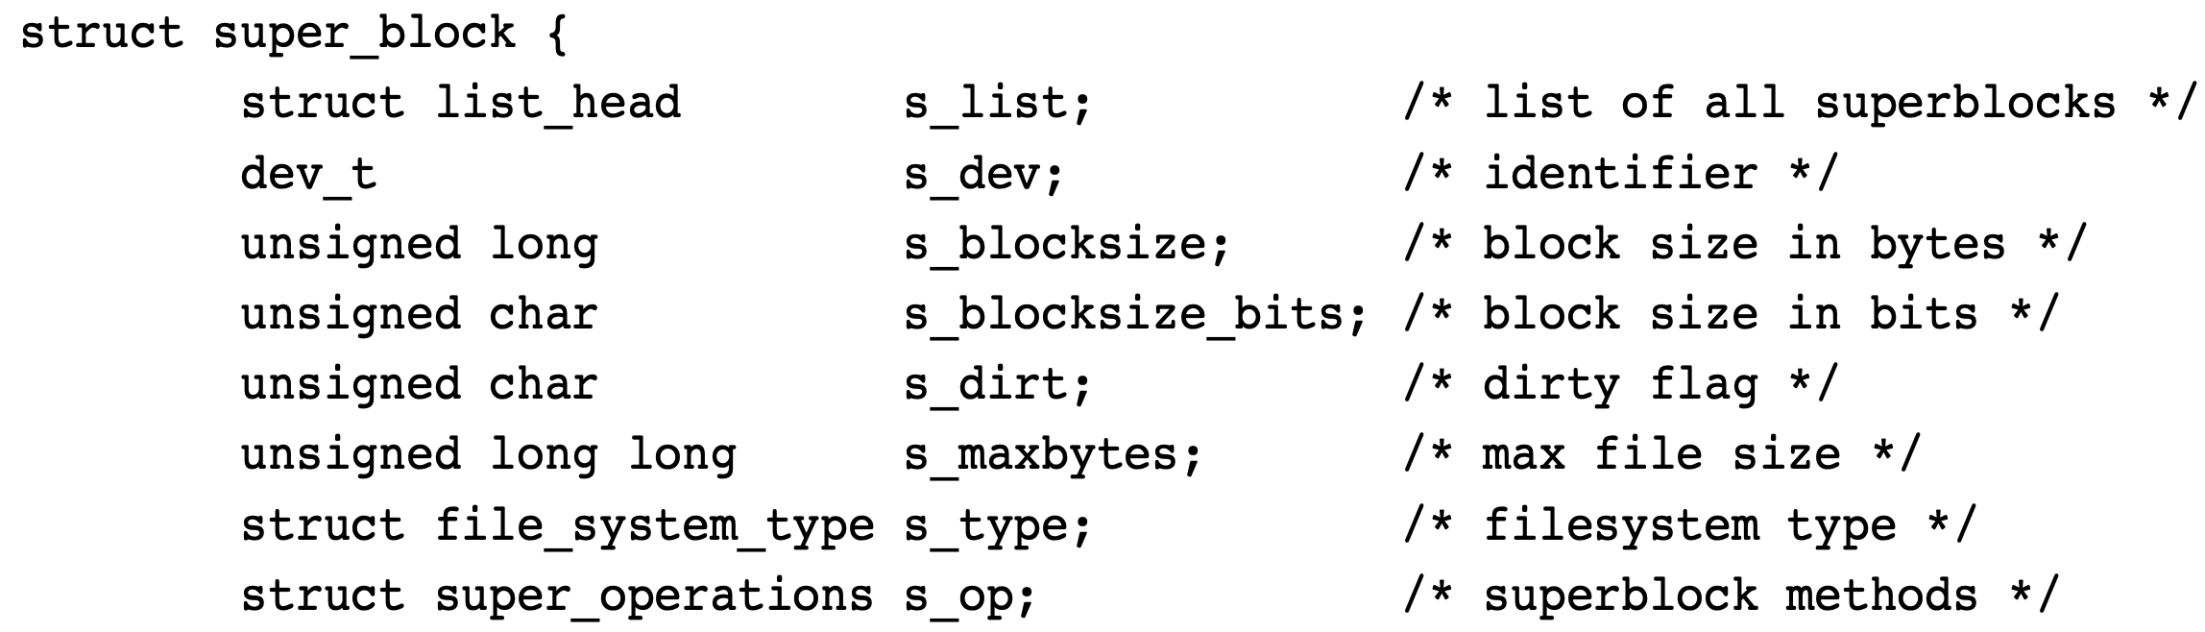
The Superblock Object
Designed to store information describing the filesystem. Also called the filesystem control block. This is stored in a special sector on disk.
When mounted, a FS invokes alloc_super(), reads its superblock off the disk, and fills in its superblock object (This object is in memory!).

Slide 16
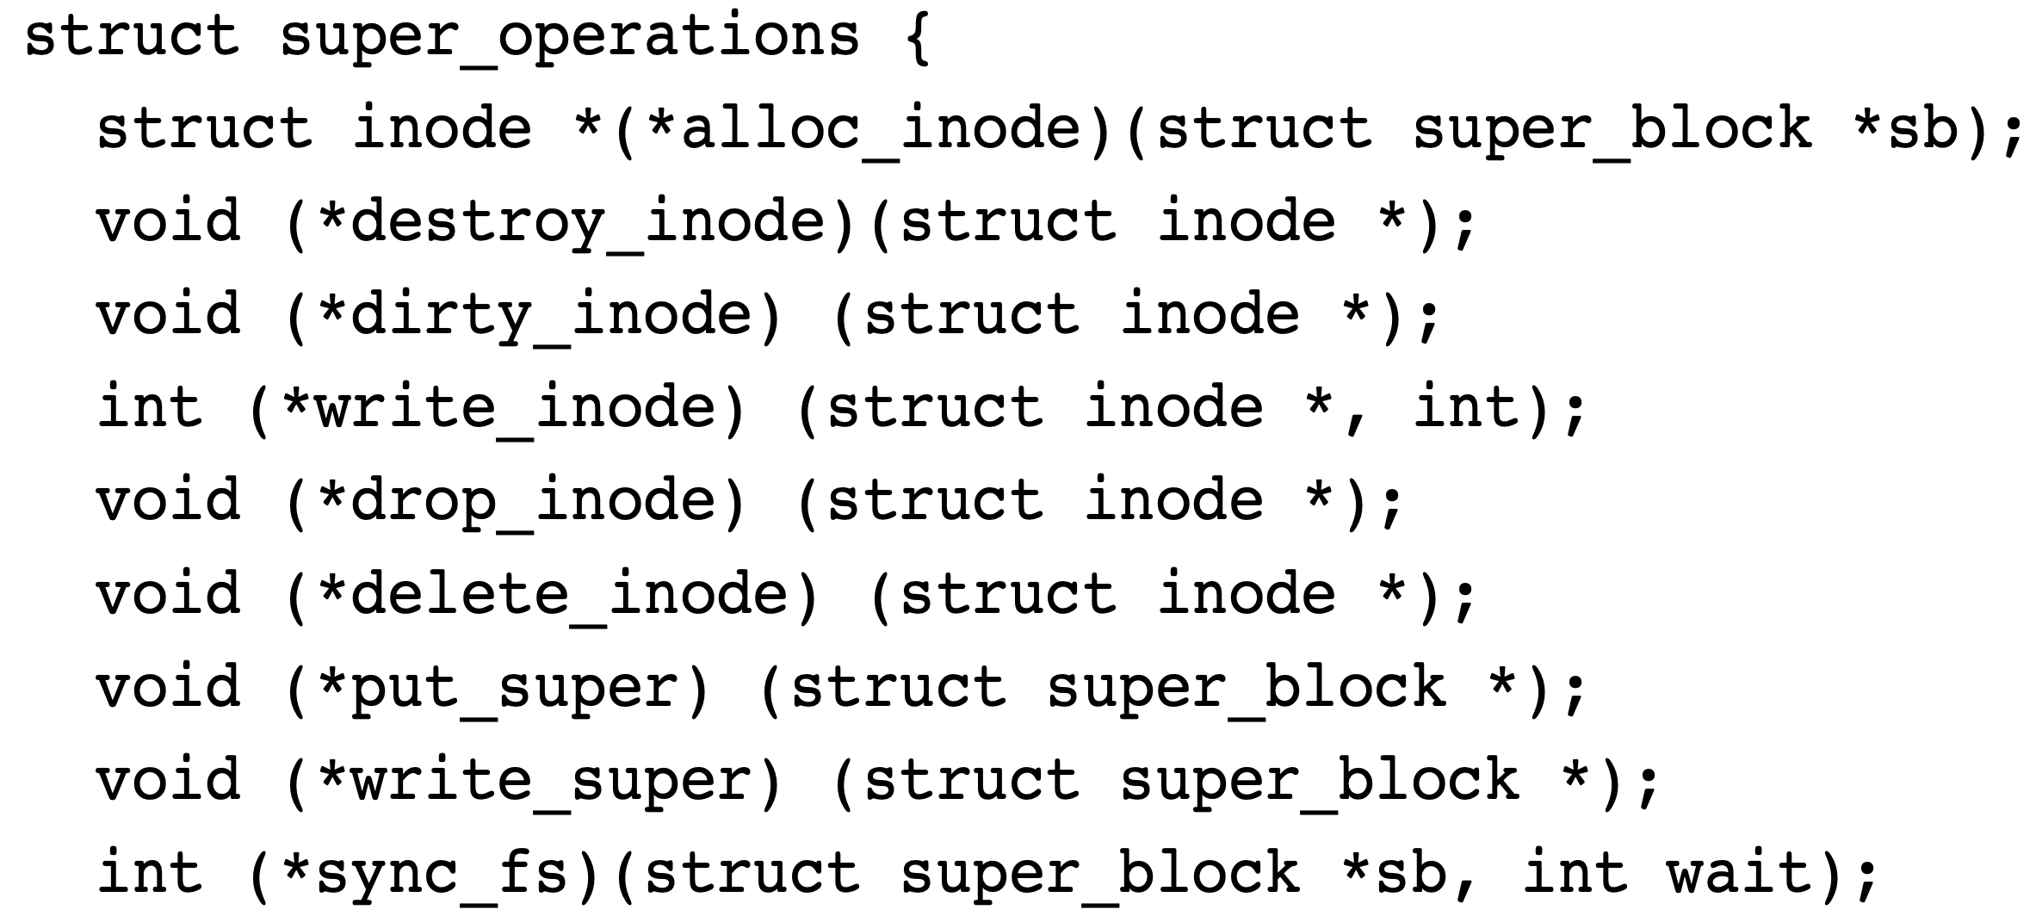
The Superblock Operations
Perform low-level operations on the filesystem and its inodes.
Ex: If a FS wanted to write to its superblock, sb → s_op → write_super(sb);
Creates & initializes a new inode object
Deallocate the given inode from memory.
When an inode is dirtied, use this function to do journal updates.
Writes the given inode to disk.
Deletes the given inode from disk.
Called when unmount. Releases the given superblock object.
Updates the on-disk superblock. Synchronizes a modified in-memory superblock with the disk.

Slide 17
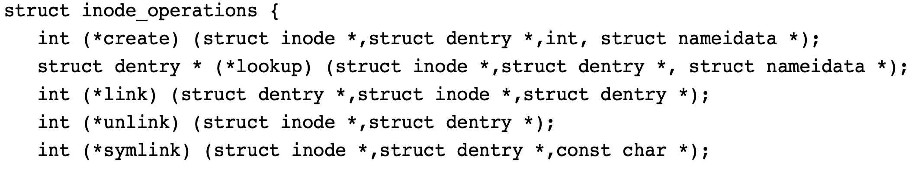
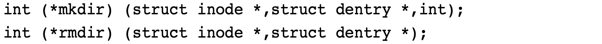
The Inode Object & Operations
Represents all the information needed by the kernel to manipulate a file.
An inode represents metadata of each file on a FS, and the inode object (or VFS inode) is constructed in memory only as files are accessed.
Creates a new inode associated with the dentry object with the access mode. (called by create() and open() system call)
(struct inode *dir, struct dentry *dentry, int mode);
(struct inode *dir, struct dentry *dentry);
Searches a directory for an inode corresponding to a filename specified in the given dentry.
(struct inode *dir, struct dentry *dentry, const char *symname);
Creates a symbolic link named symname to the file represented by dentry in the directory dir.
int (*rename) (struct inode *old_dir, struct dentry *old_dentry, struct inode *new_dir, struct dentry *new_dentry);
Removes the directory referenced by dentry from the directory dir.
Moves the file specified by old_dentry from the old_dir directory to the directory new_dir with the filename specified by new_dentry.

Slide 18
The Dentry Object
The hierarchical nature of a file system is managed by dentry objects. (Ex: /home/hello/world → Four dentry objects /, home, hello, world)
The VFS constructs dentry objects on-the-fly, as needed, when performing directory operations. (The dentry object does not correspond to any sort of on-disk data structure.)
A dentry object can be in one of the three states:
Used: Corresponds to a valid inode (d_inode) and is own by some users (d_count).
Unused: Corresponds to a valid inode, but does not belong to any user. (Just Cache)
Negative: Not associated with inode. Either the inode was deleted, or the path name was never correct. (Quickly response to the open() system call).
Both dentry objects and the corresponding inodes can be cached for faster directory lookup and file metadata accesses.
Ref: https://developer.ibm.com/tutorials/l-virtual-filesystem-switch/
Notes:
When the Linux kernel needs to access or manipulate directory information, such as performing file operations like opening, reading, writing, or navigating directories, it reads and interprets the directory entries stored on the storage device. These directory entries are read into memory and used to construct struct dentry objects within the kernel's memory.
In most file systems, directory entries are stored within the data blocks allocated for directories. File systems organize data blocks to contain information about directories and their contents, including the directory entries. Each directory within the file system has its own data blocks allocated to store its contents, which include the directory entries.
Directory entries on storage are part of the file system's metadata, stored as data blocks, and typically optimized for direct storage access and retrieval by the file system.
struct dentry objects are in-memory representations used by the kernel for efficient manipulation and traversal of directory information during the system's runtime.

Slide 19
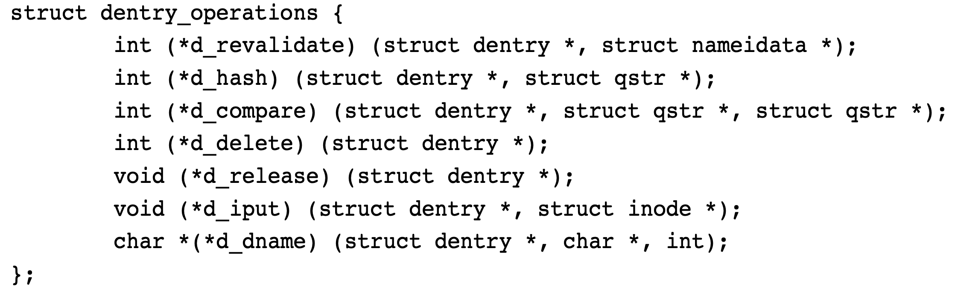
The Dentry Operations
Methods that the VFS invokes on directory entries on a given filesystem.
Creates a hash value from the given dentry. The VFS calls this whenever it adds a dentry to the hash table.

Slide 20
More about Rename
By Linux: Replace the old dentry with a new one having a new name.
Issue: Why not directly modify the name in the dentry?
Reason 1: Face consistency issue as updating the name directly is not atomic.
Reason 1 – Consistency Issue
Memory
Dentry
Inode Object
file1’s filename, inode_ptr
state, file_size, operstions , data_ptr
Updating storage is not atomic. Failure causes partial results.
Page Cache
Cached Data
File1’s Data
subdir0
File1’s Content in Data Block
Directory Block
Storage
Devices
Directory Entries
Inode Table
Inode4, file1’s filename
Inode5, file2’s filename

Slide 21
More about Rename (Count.)
By Linux: Replace the old dentry with a new one having a new name.
Issue: Why not directly modify the name in the dentry?
Reason 1: Face consistency issue as updating the name directly is not atomic.
Reason 2: If the new name is longer, and there is no space in the block.
Correct Way to Handle Inconsistent
Reason 2 – Overwriting Neighbors
Memory
Dentry
Inode Object
Storage Devices
file1’s filename, inode_ptr
state, file_size, operstions , data_ptr
Inode# 4B
Type 1B
Name (Align to 4 B, Max: 255)
The Next Directory Entry
Name_len 1B
New Name
New Dentry
Page Cache
file1’s Newname, inode_ptr
Cached Data
File1’s Data
Replace the whole directory entry. (All or Nothing, No Partial Data)
subdir0
File1’s Content in Data Block
Directory Block
Storage
Devices
Directory Entries
Directory Entry
Inode Table
Inode4, file1’s filename
Updating the Name to a longer one causes overwriting!
Inode5, file2’s filename

Slide 22
Example to Access /Path/to/File
A user process requests a file: /path/to/file
Step 1: VFS parses to get “/”, ”path”, “to”, “file” four components
Step 2: Resolves the path for each component
Check whether the dentry of the component existing or not (The root directory inode is preloaded during system boot)
(If not) VFS.inodes_operations.lookup search “path” inode from disk and create dentry.
Run the lookup function to resolve “to” and “file”

Slide 23
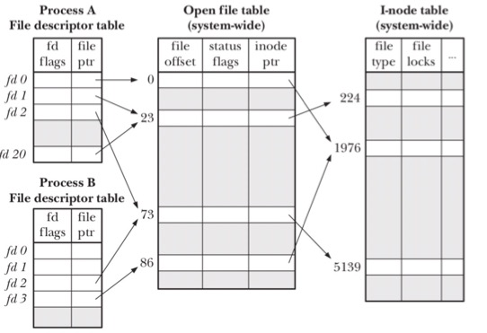
More About Dentry Object
Why there is no dentry object in the following figure?
Ans: After a file is opened, the file descriptor can directly access the corresponding inode via the open file table.
Dentry object is usually used for file path resolving.
File Path Resolving
A user process requests a file: /path/to/file
Step 1: VFS parses to get “/”, ”path”, “to”, “file” four components
Step 2: Resolves the path for each component
Check if the dentry of the component existing or not
(If not) VFS.inodes_operations.lookup search “path” inode from disk and create dentry.
Run the lookup function to resolve “to” and “file”

Slide 24
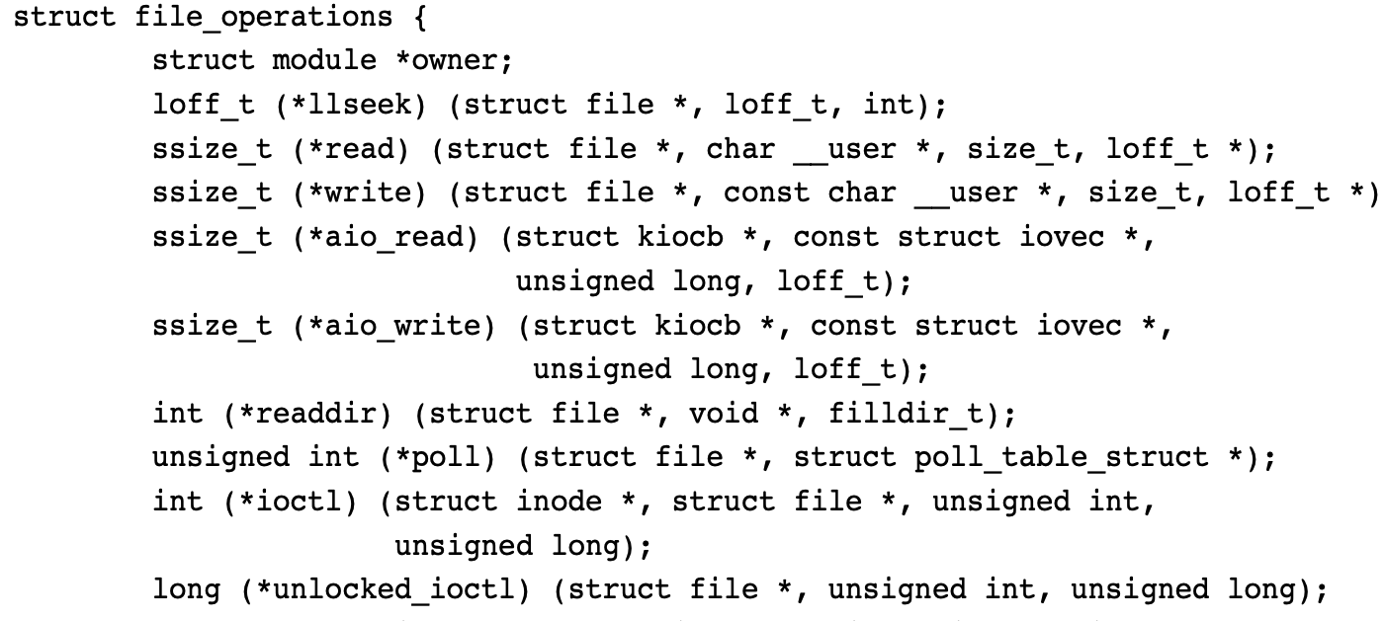
The File Object & File Operations
Represent a file opened by a process.
There may have multiple file objects for the same file. (But, each file has only one inode and one dentry.)
Like dentry object, the file object doesn’t correspond to any on-disk data.
Filesystems can implement unique functions for each of these operations, or they can use a generic method if one exists.
(struct file *file, char *buf, size_t count, loff_t *offset)
Read count bytes from the given file at position offset into buf.
Sleeps, waiting for activity on the given file.

Slide 25
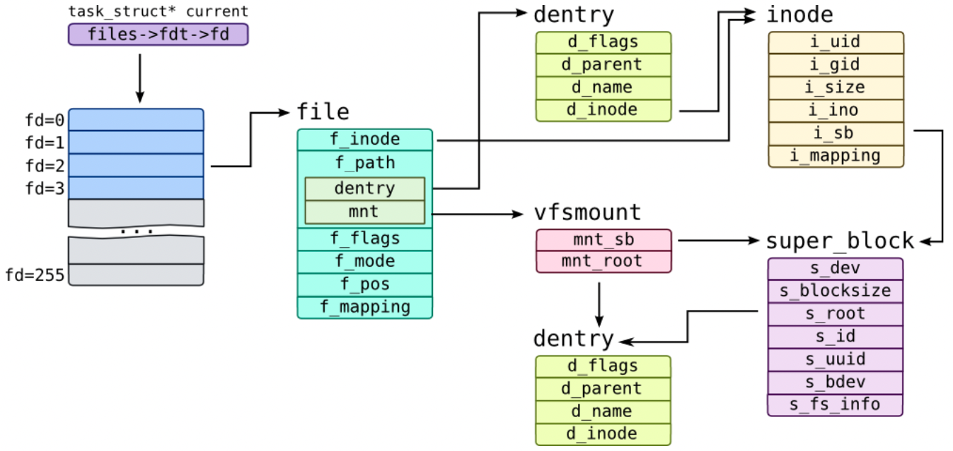
Put FS Components All Together
How does a process access a file:
Ref: https://myaut.github.io/dtrace-stap-book/kernel/fs.html

